Slide 1

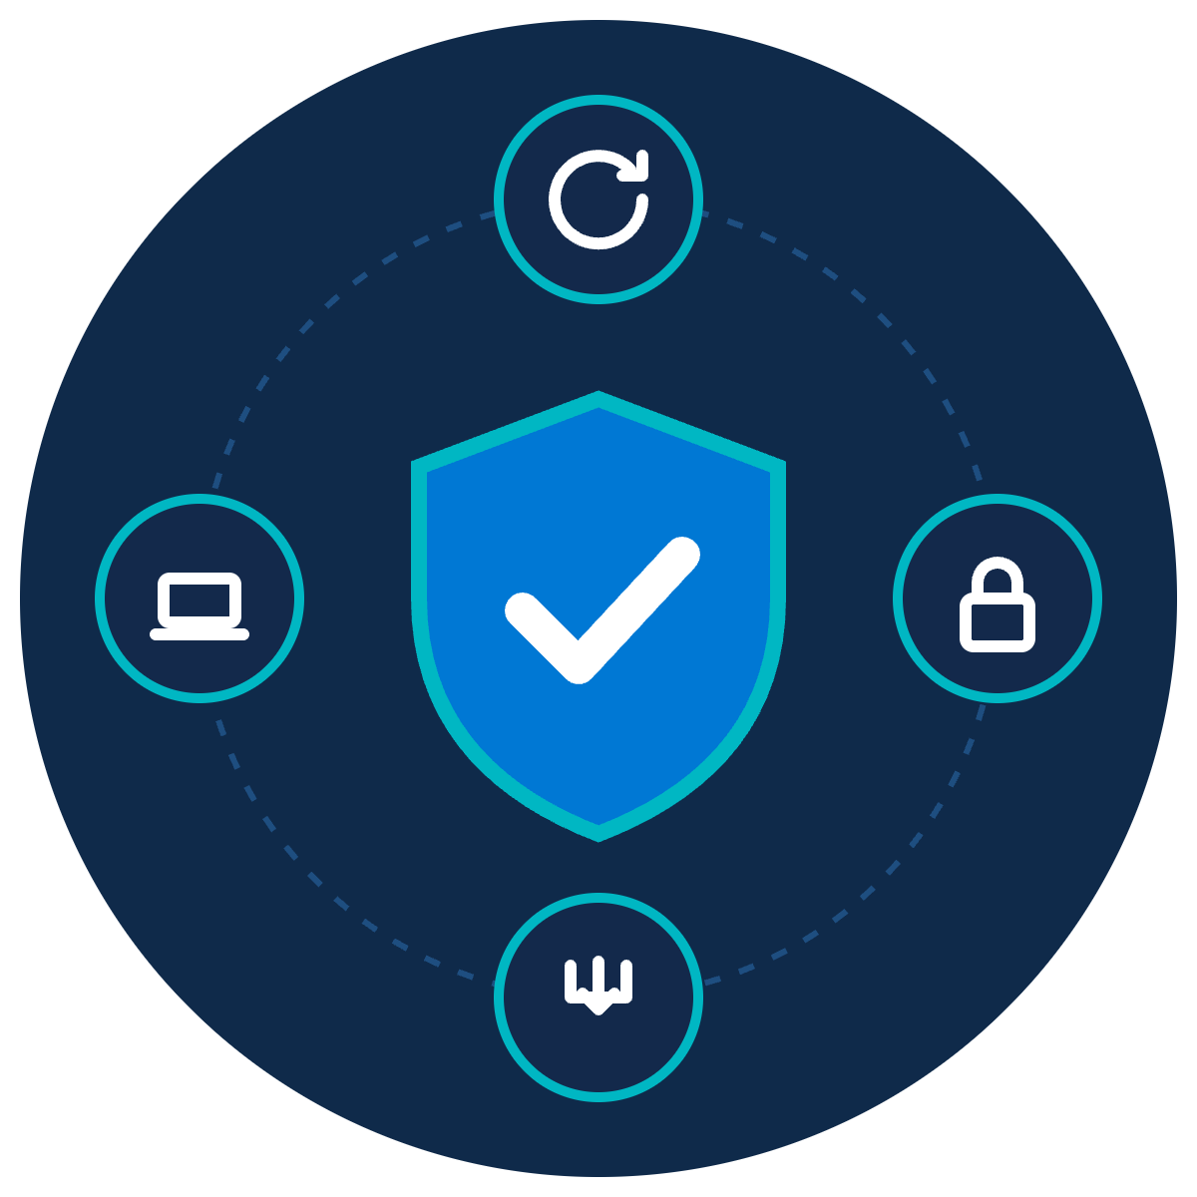
Cyber Hygiene
ZNEXORA TECH | SECURITY AWARENESS
Small Habits, Big Protection
The everyday basics that stop most attacks
Presented by: ZNexora Tech
Notes:
[0:00 – 0:40] Good [morning/afternoon], everyone. I'm [Presenter] from ZNexora Tech. In our previous sessions we've looked at some fairly dramatic threats: ransomware, stolen sessions, insider threats. Today is different. Today is about the small, everyday habits that quietly stop most of those attacks before they start. We call it cyber hygiene. None of it is complicated, and most of it takes seconds. But done consistently, these small habits give us big protection.

Slide 2






Personal hygiene for your digital life
01 · WHAT IS CYBER HYGIENE?
Small routines, done every day, that keep you, your devices and our data healthy.
AT HOME
AT WORK
Wash your hands
Install updates
Removes known weaknesses
Lock your front door
Lock your screen
Stops casual access
Copy important papers
Back up your work
Recover when things go wrong
Keep your home tidy
Clean desk
Nothing left for others to find
ZNexora Tech
ZNexora Tech · 2
Notes:
[0:40 – 1:40] So what is cyber hygiene? It's exactly like personal hygiene, but for your digital life: small routines, done every day, that keep you, your devices and our data healthy. You already do the physical versions without thinking. You wash your hands to remove germs; installing updates removes known weaknesses. You lock your front door; locking your screen stops casual access. You keep copies of important papers; backing up your work lets you recover when things go wrong. And you keep your home tidy; a clean desk leaves nothing for others to find. None of these feel like a big deal, and that's the point. They become automatic.

Slide 3




Most attacks exploit the basics
02 · WHY BASICS MATTER
31%
99%+
$4.99M
of breaches now start by exploiting an unpatched vulnerability
of identity attacks blocked by phishing-resistant MFA
global average cost of a data breach
Verizon DBIR 2026
Microsoft Digital Defense Report 2025
IBM 2026
Attackers look for the easiest way in. Good habits close those doors.
Sources: Verizon DBIR 2026 · Microsoft Digital Defense Report 2025 · IBM Cost of a Data Breach 2026
ZNexora Tech · 3
Notes:
[1:40 – 2:30] Why do the basics matter so much? Because most attacks exploit them. Verizon's 2026 report found that 31 percent of breaches now start by exploiting an unpatched vulnerability: a weakness that an update would already have fixed. Microsoft reports that phishing-resistant MFA blocks over 99 percent of identity attacks. And when the basics fail, IBM puts the global average cost of a breach at 4.99 million dollars. Attackers aren't usually looking for the hardest way in. They look for the easiest. Good habits simply close those easy doors.

Slide 4








Eight habits that make the difference
03 · THE HABITS
1
2
3
4
Update
Lock
Back up
Clean desk
5
6
7
8
Strong logins
Think before you click
Use approved tools
Report
We'll look closely at the first four, then quickly at the rest.
ZNexora Tech
ZNexora Tech · 4
Notes:
[2:30 – 3:00] Here are the eight habits that make the difference: update, lock, back up, keep a clean desk, use strong logins, think before you click, use approved tools, and report. We'll look closely at the first four, which are the everyday basics this session is about, and then quickly cover the other four, which we've explored in more depth in earlier sessions.

Slide 5


Install updates promptly
HABIT 1 · UPDATE
WHAT TO DO
WHY IT MATTERS
Updates fix security holes that attackers already know about. Every day you delay is a day the door stays open.
Install updates when prompted, don't postpone
Restart your computer at least once a week
Update your phone and its apps too
QUICK TIP
Remove apps you no longer use
Postponing? Pick a time today, like lunch, and restart then.
ZNexora Tech
ZNexora Tech · 5
Notes:
[3:00 – 4:00] Habit one: install updates promptly. When your computer or phone asks to update, don't keep clicking 'remind me later'. Restart your computer at least once a week, because many updates only finish when you restart. Update your phone and its apps too, since they hold your email, chats and MFA codes. And remove apps you no longer use, because every app is something else that needs patching. Why does it matter? Updates fix security holes that attackers already know about, and often already exploit. Every day you delay is a day that door stays open. A quick tip: if you can't restart right now, pick a time today, like lunchtime, and do it then.

Slide 6

Lock it when you leave it
HABIT 2 · LOCK
WHAT TO DO
WHY IT MATTERS
An unlocked screen lets anyone read your email, send messages as you, or copy files, in seconds.
Windows: press Win + L
Mac: press Ctrl + Cmd + Q
Set your phone to auto-lock quickly
QUICK TIP
Never share your PIN or password
Make it muscle memory: stand up, lock, then walk away.
ZNexora Tech
ZNexora Tech · 6
Notes:
[4:00 – 5:00] Habit two: lock it when you leave it. Every time you step away from your desk, even for a minute, lock your screen. On Windows, press the Windows key and L. On a Mac, press Control, Command and Q. Set your phone to auto-lock quickly, and never share your PIN or password, even with colleagues. Why does it matter? An unlocked screen lets anyone read your email, send messages as you, or copy files, and it takes only seconds. It's also one of the easiest ways for a visitor or an insider to cause harm. The tip: make it muscle memory. Stand up, lock, then walk away.

Slide 7
Back up so you can bounce back
HABIT 3 · BACK UP
THE 3-2-1 RULE
AT WORK
3
2
1
Save work to [OneDrive / SharePoint / company drive]
copies
storage types
off-site
Not only on your desktop or a USB drive
Back up your phone and personal files too
Three copies of important data, on two types of storage, with one kept off-site or in the cloud.
Report anything missing or locked straight away
A backup you've never restored is only a hope. Test it.
ZNexora Tech
ZNexora Tech · 7
Notes:
[5:00 – 6:00] Habit three: back up so you can bounce back. Ransomware, a lost laptop, a spilled coffee or an accidental delete can all wipe out your work. A simple rule is 3-2-1: three copies of important data, on two different types of storage, with one kept off-site or in the cloud. At work, that mostly happens for you, as long as you save your work to [OneDrive, SharePoint or the company drive], not only on your desktop or a USB drive. Back up your phone and personal files too. And if files suddenly go missing or won't open, report it straight away. One last point, mostly for IT: a backup you've never restored is only a hope. Test it.

Slide 8

Keep a clean desk and clear screen
HABIT 4 · CLEAN DESK
WHAT TO DO
WHY IT MATTERS
Visitors, cleaners and video calls can all see what's on your desk or screen. Paper leaks data too.
No passwords on sticky notes
Lock away papers and devices when you leave
Collect printouts straight away; shred, don't bin
QUICK TIP
Wipe whiteboards after meetings
Before you leave each day: clear the desk, lock the drawer, log off.
ZNexora Tech
ZNexora Tech · 8
Notes:
[6:00 – 7:00] Habit four: keep a clean desk and a clear screen. No passwords written on sticky notes, under keyboards or on monitors. Lock away papers and devices when you leave your desk at the end of the day. Collect printouts straight away, and put confidential paper in the shredding bin, not the normal bin. And wipe whiteboards after meetings. Why does it matter? Visitors, cleaners, delivery staff and even people on your video calls can see what's on your desk or screen. Paper leaks data just as easily as email. The tip: before you leave each day, clear the desk, lock the drawer and log off.

Slide 9

Four more habits, in brief
HABITS 5 TO 8
Strong logins
Think before you click
Use a password manager, unique passwords and MFA. Never approve a prompt you didn't start.
Pause on urgent or unexpected messages. Check the sender and the link.
Use approved tools
Report
No personal email, cloud, USB or public AI tools for company data.
Something odd? Tell IT on [contact] straight away. No blame.
Covered in depth in our phishing, session theft and insider threat sessions.
ZNexora Tech
ZNexora Tech · 9
Notes:
[7:00 – 7:50] Here are the other four habits, in brief. Strong logins: use a password manager, a unique password for every account, and MFA, and never approve an MFA prompt you didn't start. Think before you click: pause on urgent or unexpected messages, and check the sender and the link. Use approved tools: no personal email, personal cloud storage, USB drives or public AI tools for company data. And report: if something seems odd, tell IT on [contact] straight away. You will never be blamed for reporting. We've covered these in more depth in our phishing, session theft and insider threat sessions.

Slide 10






Your daily cyber hygiene routine
04 · PUTTING IT TOGETHER
Start of day
Stepping away
During the day
End of day
Monthly
Install pending updates; check for odd sign-in alerts
Lock your screen, every time
Pause before clicking; save to approved storage
Clear desk, lock drawer, log off or lock
Restart, review apps, check your backups
Altogether, it takes just a few minutes a day.
ZNexora Tech
ZNexora Tech · 10
Notes:
[7:50 – 8:40] Let's put it together into a simple daily routine. At the start of the day, install any pending updates and glance at any unusual sign-in alerts. Every time you step away, lock your screen. During the day, pause before clicking and save your work to approved storage. At the end of the day, clear your desk, lock your drawer and log off or lock. And once a month, restart, review the apps you have installed, and check your backups are working. Altogether, that takes just a few minutes a day.

Slide 11

How healthy is your cyber hygiene?
05 · SELF-CHECK
My devices are fully updated
I lock my screen every time I leave
My work is saved to approved storage
No passwords on notes or my desk
I use a password manager and MFA
I never approve MFA prompts I didn't start
I use only approved apps and storage
I know how to report a problem
Missed any? Pick one habit and start it today.
ZNexora Tech
ZNexora Tech · 11
Notes:
[8:40 – 9:30] Let's finish with a quick self-check. Count how many of these are true for you. My devices are fully updated. I lock my screen every time I leave. My work is saved to approved storage. There are no passwords on notes or my desk. I use a password manager and MFA. I never approve MFA prompts I didn't start. I use only approved apps and storage. And I know how to report a problem. If you ticked all eight, great work. If you missed any, don't worry: pick one habit and start it today. Small changes add up quickly.

Slide 12
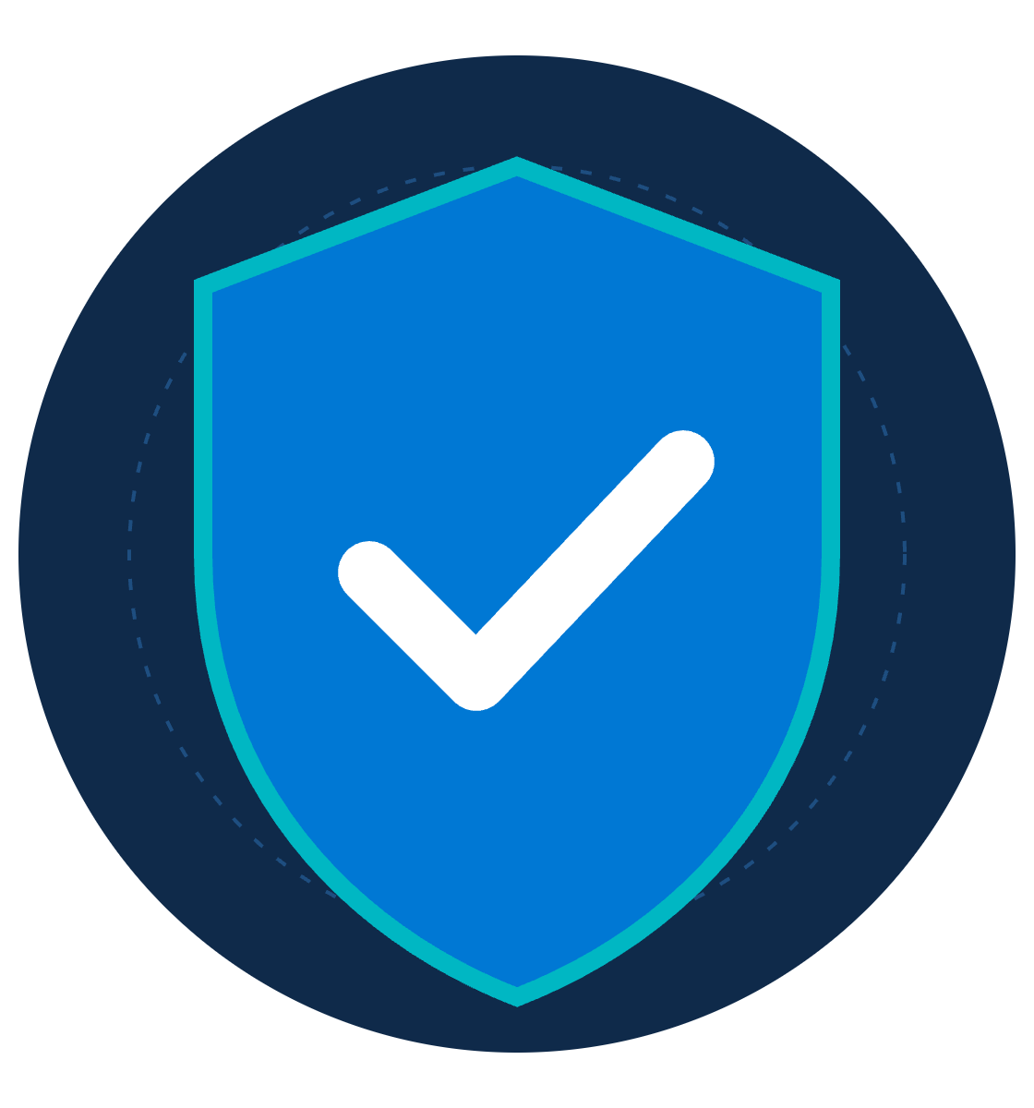
Small habits. Big protection.
QUESTIONS AND DISCUSSION
Update. Lock. Back up. Keep it clean. Start today.
Thank you · Presented by ZNexora Tech
Notes:
[9:30 – 10:00] To wrap up: cyber hygiene isn't about being a security expert. It's about small habits, done every day: update, lock, back up, and keep it clean. They take seconds, but together they stop most attacks before they start. Small habits, big protection. Start today. Thank you. I'm happy to take any questions.

